Slide 1
Recognizing hand-written digits (MNIST)
ARAVIND R
Ioa BATCH - 9

Slide 2
Project objective
The goal is to correctly identify digits from a dataset of tens of thousands of handwritten images.
To use dimensionality reduction technique and build machine learning algorithms like decision trees, random forest, etc on top of it.
To use artificial neural network using keras in python

Slide 3
Problem description
The concurrent availability of inexpensive powerful computer, large databases & powerful learning algorithms, have caused rapid progress in recognizing hand-written digits in the last few years.
By teaching the computers, one can easily transform any hand-written digits in a way that it can understand and return computerized digits in its display.

Slide 4
Data set description
Mnist (“Modified National Institute of Standards and Technology”) is the hello world dataset of computer vision. Since its release in 1999, this classic dataset of handwritten images has served as the basic for benchmarking classification algorithms.
The data consists of pixel values of hand written digits (image 28*28) and each row corresponds to its digit (0-9).

Slide 5
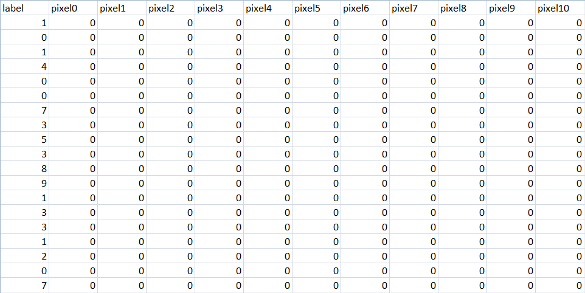
DATA SET Train & Test
Task : multi-classification (0-9)
Training set : 420k rows, 784 predictors, 1 target variable
Test set : 280k rows, 784 columns
Predictors : pixel values between 0 – 255
Response : label (digit 0-9)

Slide 6
Flow diagram
PROBLEM DEFINITION
IMPORT DATA
VISUALIZE DATA
SPLIT/SCALE/CENTER TRAIN DATA
DIMENSIONALITY REDUCTION - PCA
1. MODEL BUILDING WITH PCA COMPONENTS
(DECISION TREE,RANDOM FOREST, K-NN, SVM,XGBOOST)
2. NEURAL NETWORKS USING KERAS IN PYTHON
COMPARISON OF RESULTS/ACCURACY

Slide 7
algorithms to be used
1 . Principal component analysis
Decision tree
Random forest
K- Nearest neighbors
Support vector machine
xgboost
2. NEURAL NETWORKS USING KERAS IN PYTHON

Slide 8
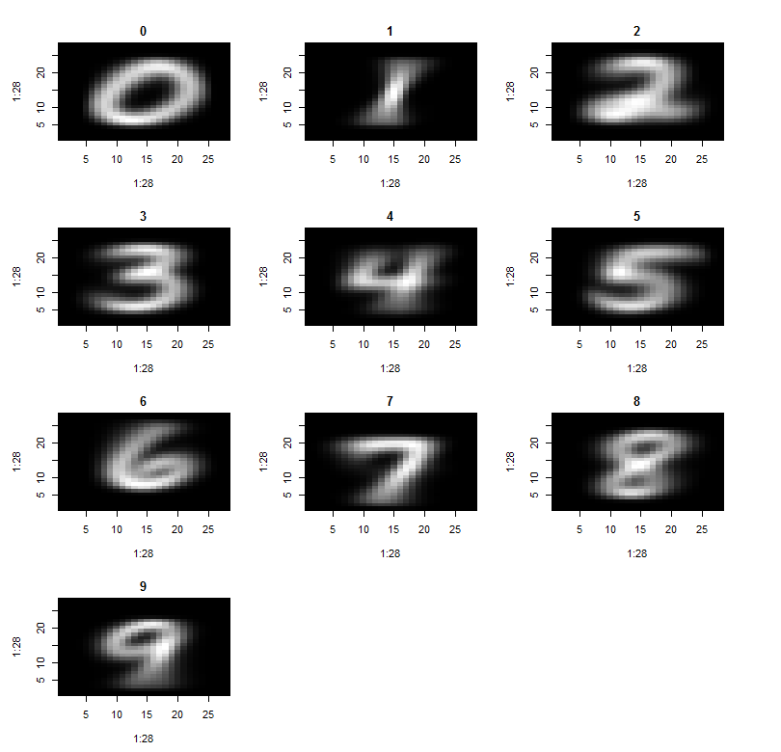
Algorithm description
Average image of each digit
Create an array of 10 * (28*28)
Use a for loop to iterate through all the digits
Find the sum of pixel values of each digit and then divide it by 255*255 to get the average value
Load this array in to a new array of dim 28*28 and use image function.

Slide 9
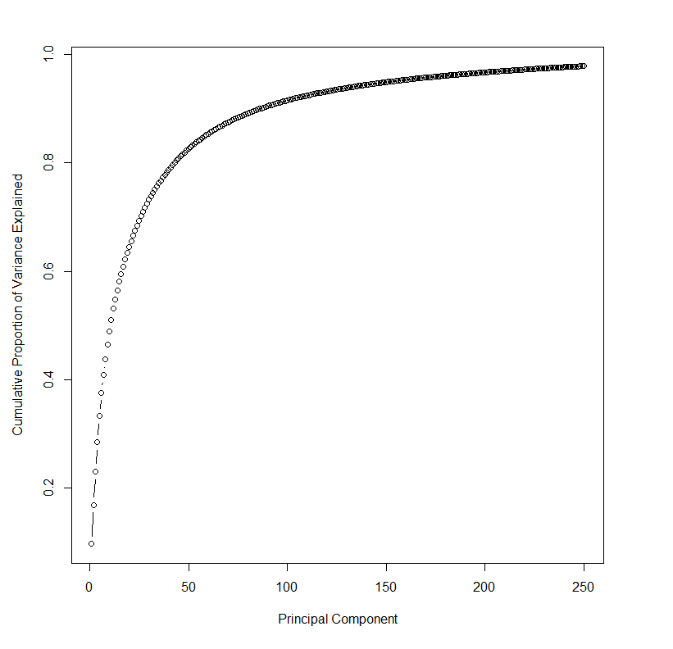
Principal component analysis
Principal component analysis is used to transform a number of (possibly) correlated variables into a (smaller) number of linearly uncorrelated variables called principal components
A plot between the principal components (X-axis) and Cumulative proportion of variance (Y-axis) shows that the 250 pc’s are enough to explain almost 100% of variance.

Slide 10
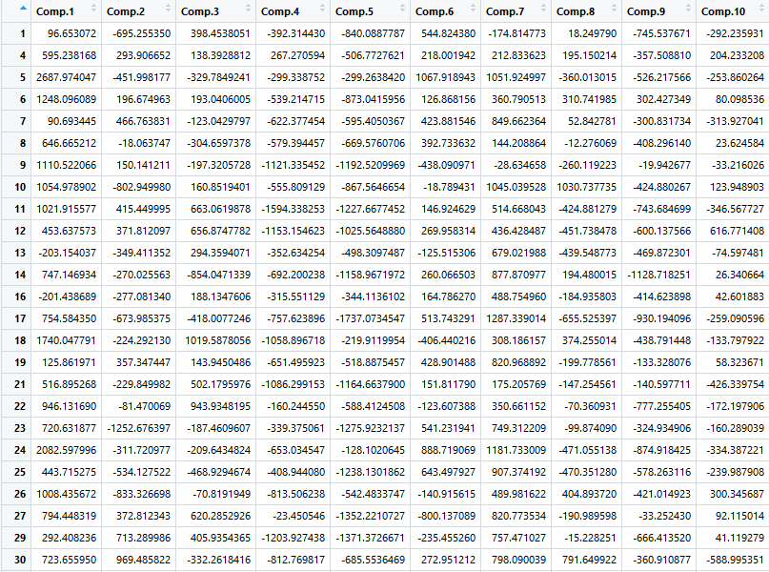
Data after using pca

Slide 11
Decision tree
Decision tree algorithm pseudo code :
Place the best attribute of the dataset at the root of the tree.
Split the training set into subsets. Subsets should be made in such a way that each subset contains data with the same value for an attribute.
Repeat step 1 and step 2 on each subset until you find leaf nodes in all the branches of the tree.

Slide 12
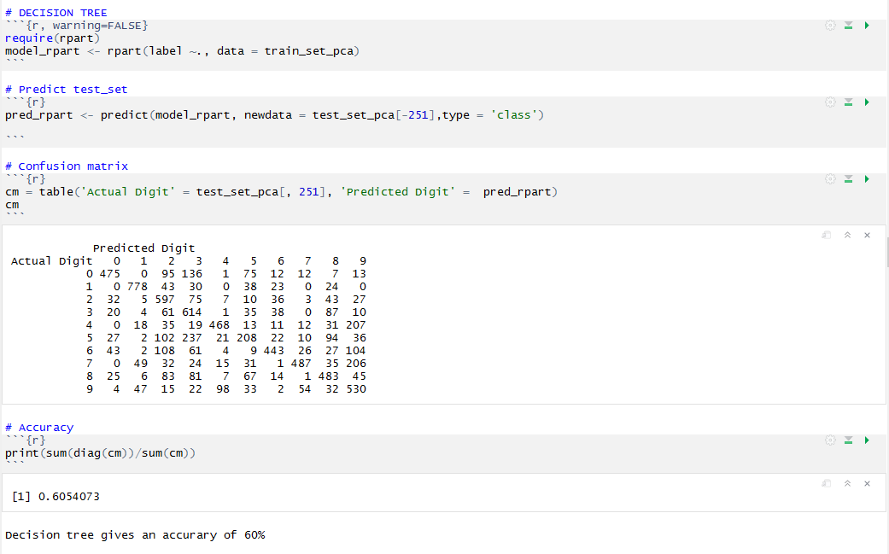
Decision tree – r code

Slide 13
RANDOM FOREST
Random forest pseudocode:
Randomly select “k” features from total “m” features.
Where k << m
Among the “k” features, calculate the node “d” using the best split point.
Split the node into daughter nodes using the best split.
Repeat 1 to 3 steps until “l” number of nodes has been reached.
Build forest by repeating steps 1 to 4 for “n” number times to create “n” number of trees.

Slide 14
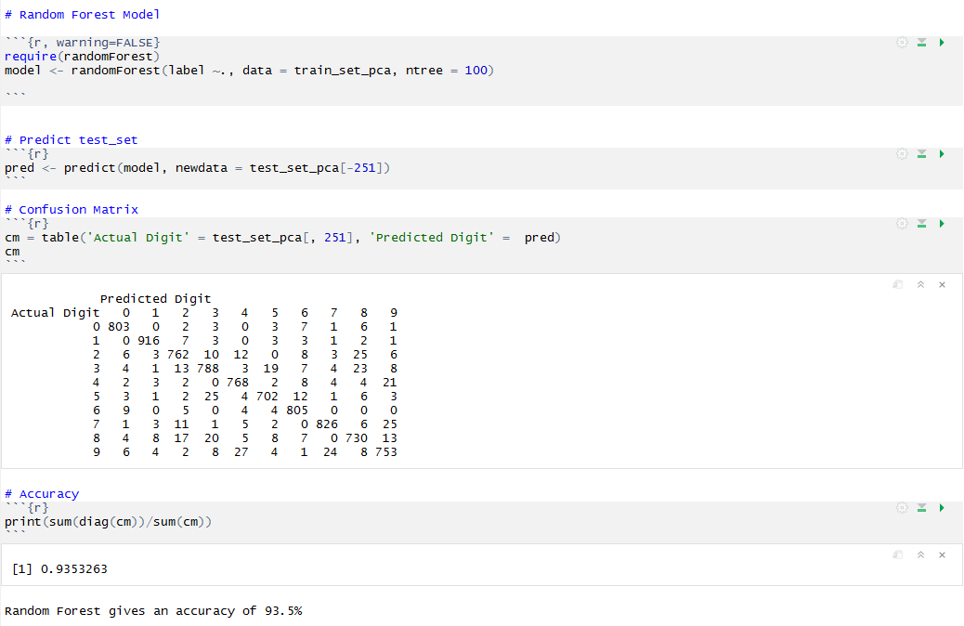
RANDOM FOREST – R CODE

Slide 15
K-Nearest neighbours
Go through each item in my dataset, and calculate the "distance" from that data item to my specific sample.
Classify the sample as the majority class between k samples in the dataset having minimum distance to the sample.

Slide 16
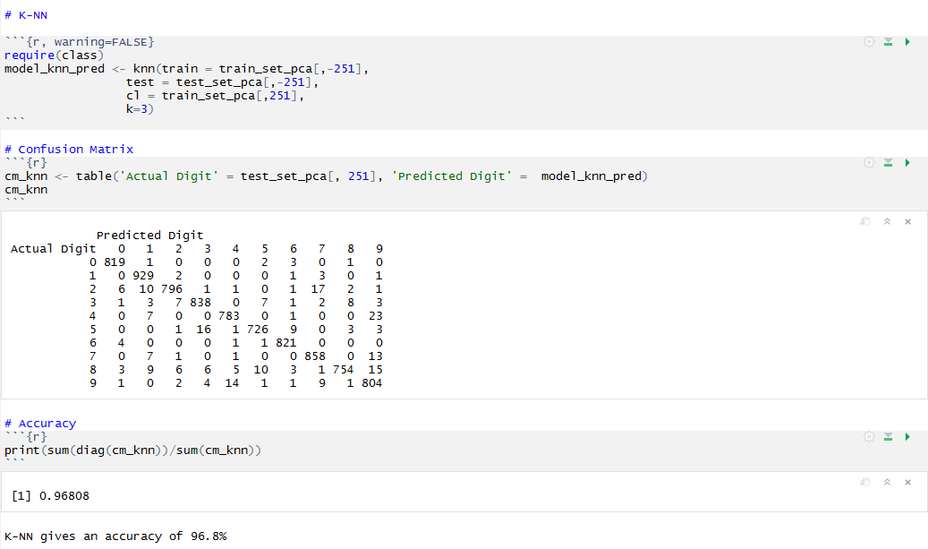
K-NN - R code

Slide 17
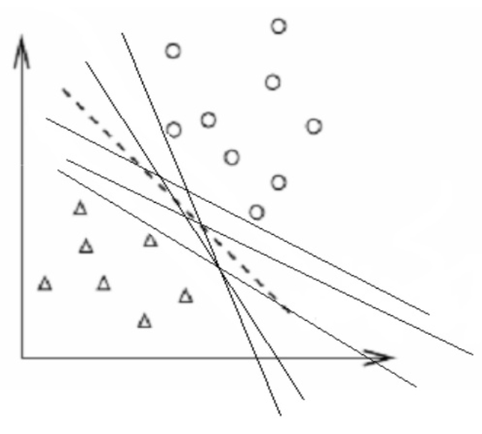
SUPPORT VECTOR MACHINE
Identify the line that will classify the unseen data well.
The line (dotted line) which has the maximum margin is selected.

Slide 18
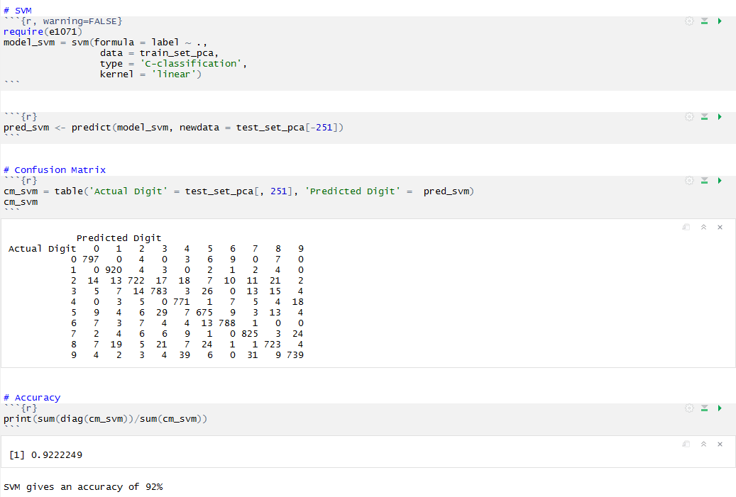
SVM – r code

Slide 19
xgboost
It is an machine learning algorithm that builds a strong model based on many weaker ones sequentially. To do so, it uses gradient descent. When this technique is used with decision trees, it is called gradient boosting trees.
It runs a bunch of weak learner regression trees and re-weighting the data after each new weak learner is added into the mix.

Slide 20
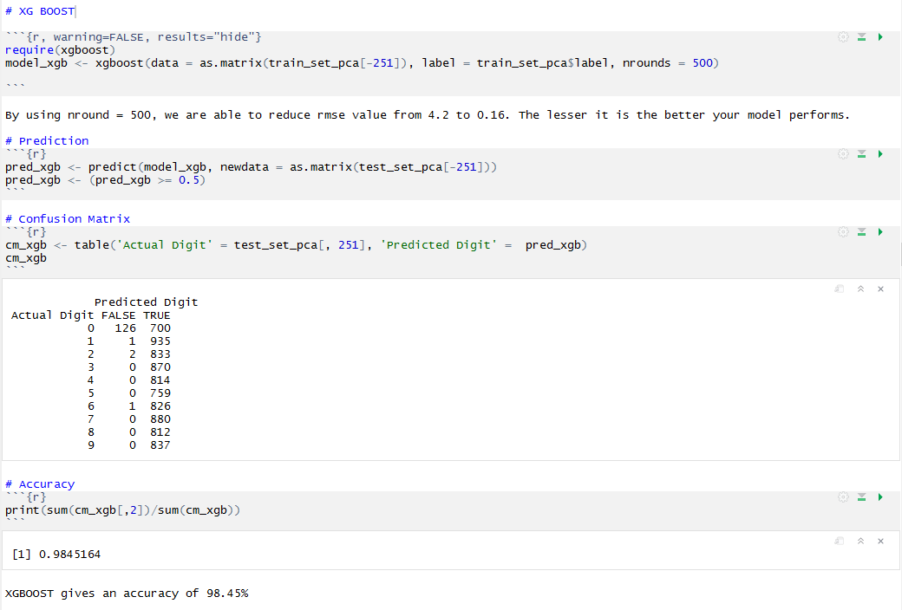
XGBOOST – r code

Slide 21
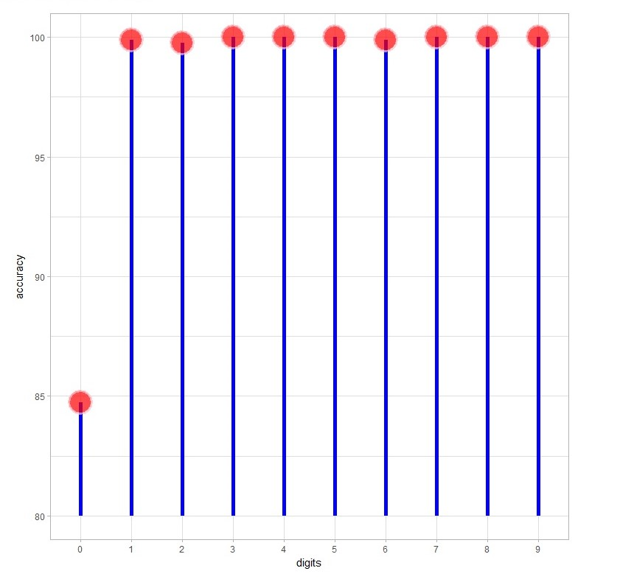
LOLLIPOP PLOT (Accuracy of each digit)

Slide 22
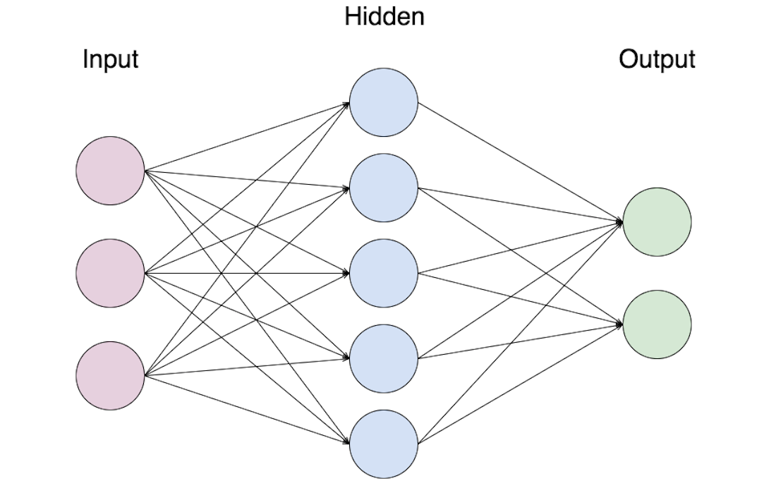
Neural networks
Feed the input in the first layer
Forward propagation:
Input Layer – Hidden Layer(s) – Output Layer
Compare predicted result with the actual values and measure the error.
Back propagation: The error is back propagated and the weights are updated so that the error is reduced.
Repeat the steps until the error is minimized.
This entire process makes one epoch. Do multiple epochs.

Slide 23
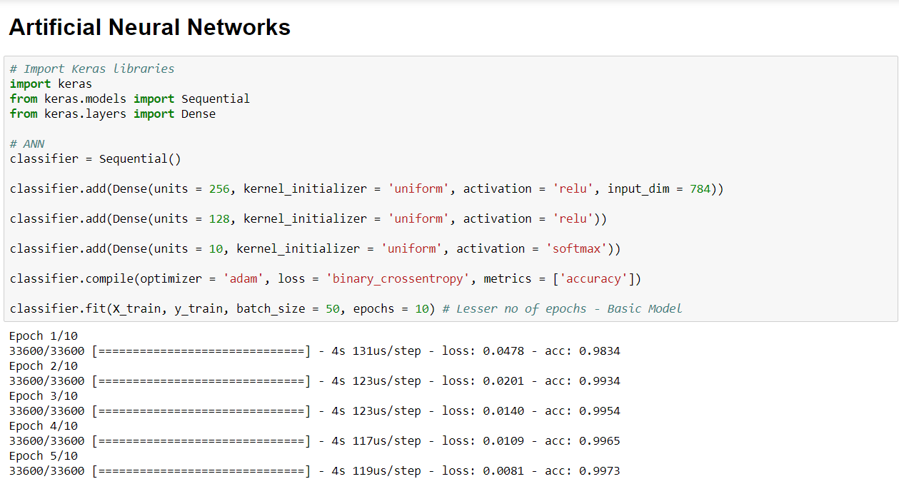
Neural networks - python

Slide 24
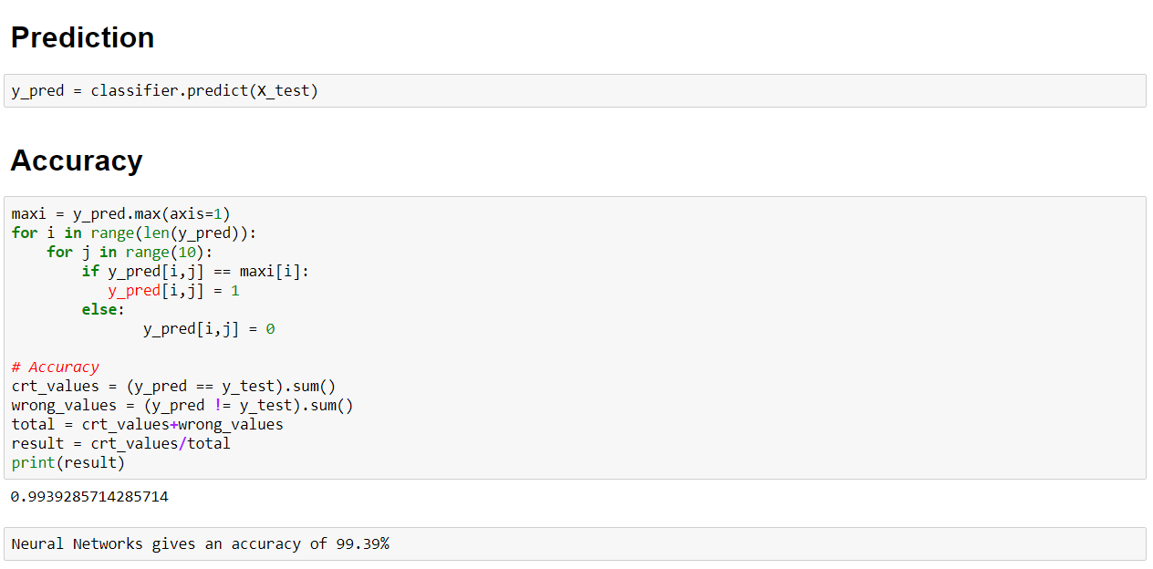
NEURAL NETWORKS - ACCURACY

Slide 25
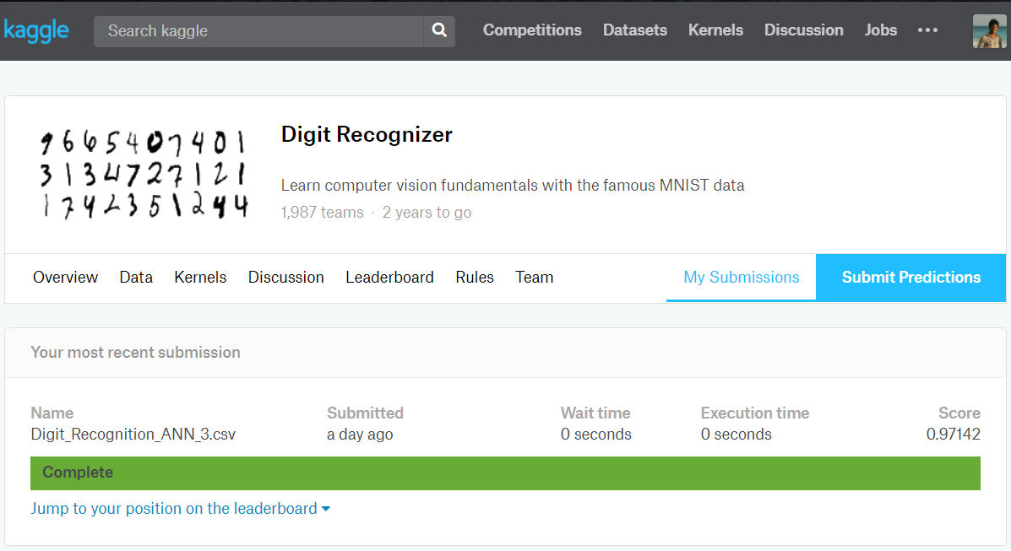
KAGGLE SCORE

Slide 26
Expected outcome
1. PCA in r – 250 Principal components
Decision tree – 60 % accuracy
Random forest – 93.5% accuracy
K-NN – 96.8% Accuracy
SVm – 92% Accuracy
Xgboost – 98.45% accuracy
2. Neural network using keras (python) – 99.39%

Slide 27
Thank you.!

